Slide 1
Tolson And Associates,LLC
Capitol Raceway RD.
Crofton, Maryland

Slide 2
Tolson And Associates, LLC
Sand & Gravel Mining Operation
MDE Permit No. 78-SP-0087-J
Construction & Demolition Rubblefill
MDE Permit No. 2003-WRF-0580
Rubblefill Recycling Activities
Natural Wood Waste (Mulch) Permitted MDE
Tier 1 Compost (Yard Waste) Permitted MDE
Metal, Tires, OCC, Wood Waste
Recycled Aggregate Products
Application for MDE Permit for Construction and Operation of a Crushing Operation Submitted 11/14/2018

Slide 3
Location - Area Map

Slide 4
Site Map
Active Mine Area
Active C&D Disposal Area
Mulch /Compost
Concrete Crushing
Wash Plant
Closed Landfill
Gate /Scale House

Slide 5
Application Submittal
Cover Letter
MDE Form 5 - Application for Processing/ Manufacturing Equipment
MDE Form 5EP - Emissions Data Point
MDE Form 5T - (TAP) Emissions Summary and Compliance Demonstration
MDE Form 44 - Air Quality Permit to Construct and Registration Application for Internal Combustion Engines

Slide 6
Application Submittal
Emissions Calculations - All engines in Crushing operation (Train)
Site Map
Drawings and Vendor Literature
Fugitive Dust Control Program
Anne Arundel County Zoning Letter Verifying Crushing Operations is a Permitted Use
Opacity Testing

Slide 7
Crushing Operations Flow
Trucks Enter – Capital Raceway Road
Gate – Scale House
Trucks weighed and inspected
Sent to crushing area where material is placed in stock piles to be processed
Return to Scale House and weighed out
Material Process
Screened & Sized
Jaw Crusher
Impact Crusher
Screened & Sized
Stock Piles – Recycled Aggregate Products
Recycled Aggregate Products
RC – 4”-6” Gravel
RC – 2” Gravel
RC - ¾” Gravel
Crusher Run
Select Fill

Slide 8
Crushing Equipment

Slide 9
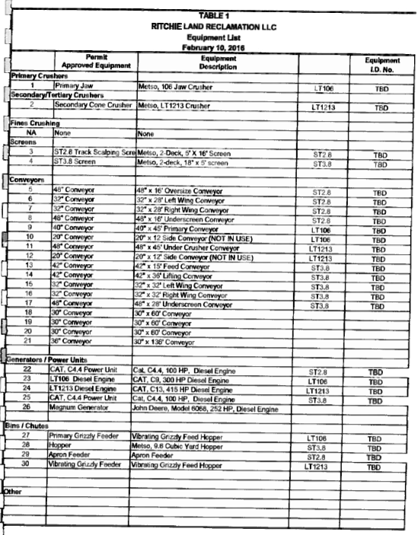
Crushing Equipment

Slide 10
Crushing Equipment

Slide 11
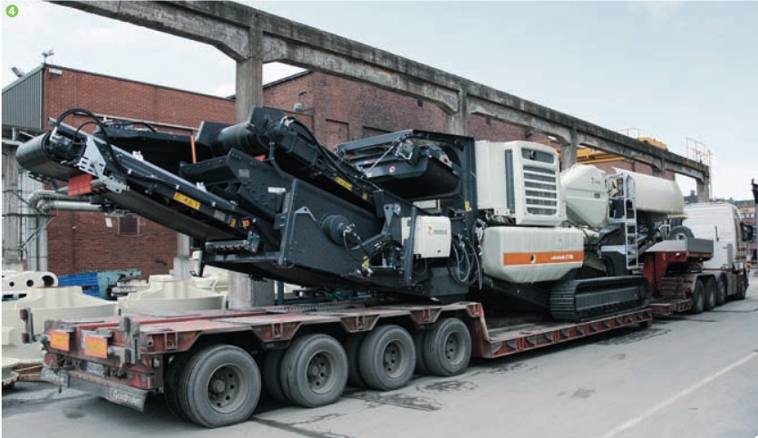
Crushing Equipment

Slide 12
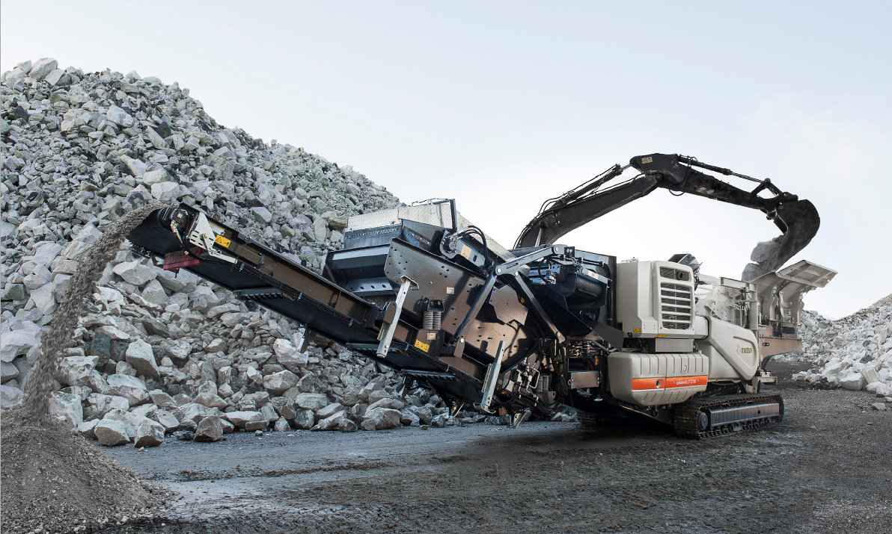
Crushing Equipment

Slide 13
Crushing Equipment

Slide 14
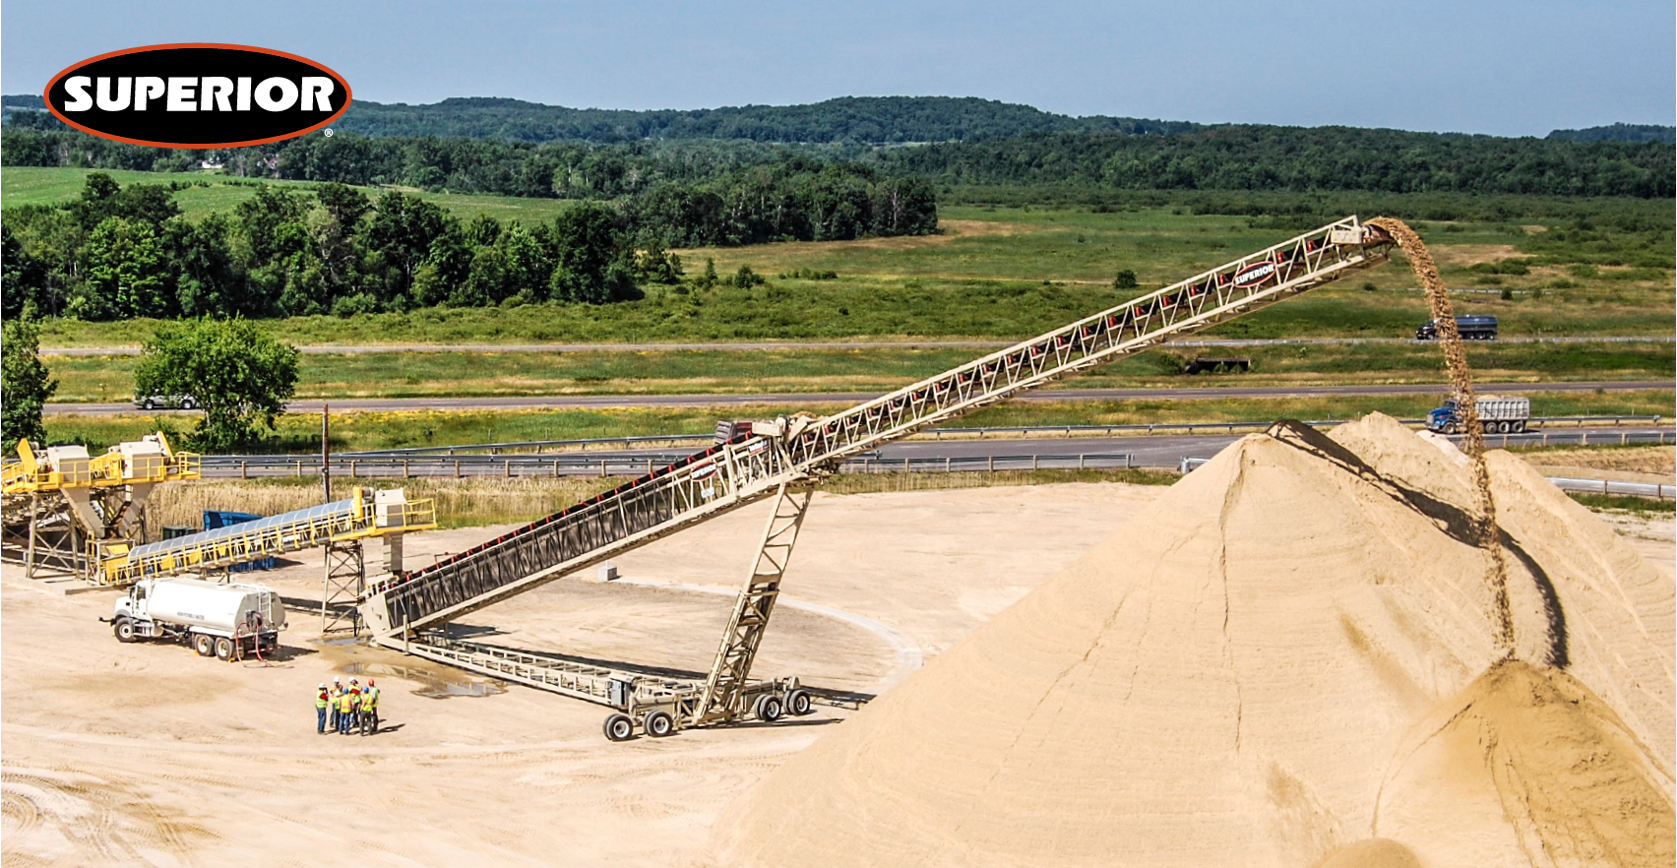
Crushing Equipment

Slide 15
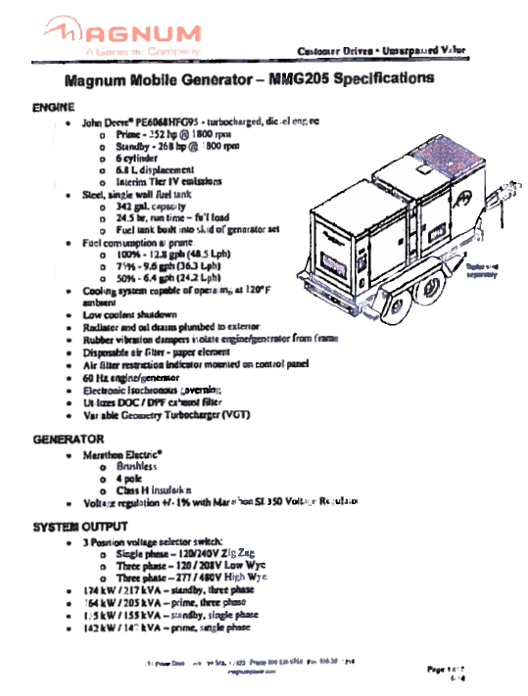
Crushing Equipment

Slide 16
Fugitive Dust Control
Fugitive Dust Control – Crushing operation
TOLSON & ASSOCIATES
End of Capitol Raceway Road
Crofton, Maryland 21114
Equipment and conveyors equipped with conveyor duct covers and discharge hoods and high pressures water spraying system
Best Management Practices will be used to control emissions of particulate matter from roadways, stockpiles and materials handling operations
Avoid overfilling loader buckets and minimize drop heights.
Wet suppression system to be used whenever necessary to control particulate emissions.
Water and or chemical dust suppressants to be used to control fugative dust from roads or stockpiles.
Control Traffic Speeds and Flush sweep roadways as necessary.
Minimize work of stockpiles on windy days

Slide 17
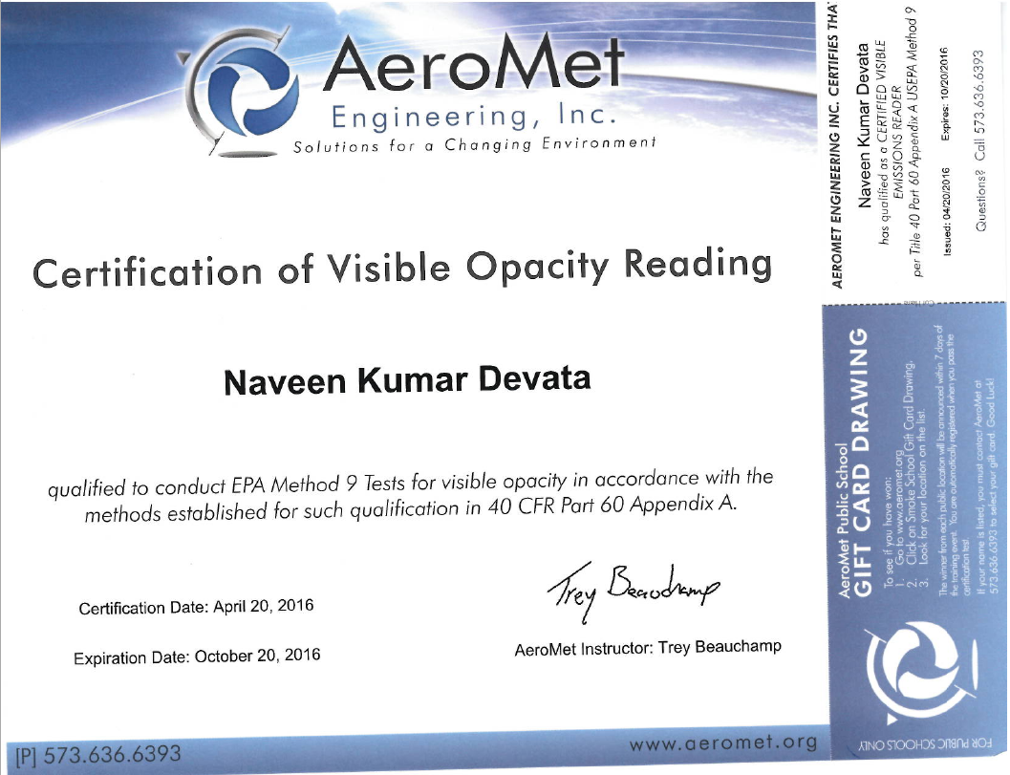
Opacity Testing

Slide 18
Tolson & Associates, LLC
Thank You
Any questions?

